Slide 1
Employee engagement
The Increasingly not so Secret Sauce of Strategic Energy Management

Slide 2
Agenda
Introduction
Overview of strategic energy management
Value of strategic energy management
Role of employee engagement in strategic energy management

Slide 3


A Brief Introduction to Ecova
Total Energy & Sustainability Management Solutions
Growing results on saving resources – cost-effectively
28 Million MWh saved
Over 50 utilities and energy efficiency leaders
Over $18B in expenditures under management
500,000 commercial sites
Notes:
Enough saved through utility programs to power 2.3 million homes for a year
We have relationships with all the major IOUs
Our C&I clients represent 25% of the Fortune 500

Slide 4
Why does SEM even matter?
Energy Management
Energy Management
SEM
SEM

Slide 5
Defining SEM
Definition – (pending finalization with CEE)
Strategic Energy Management can be defined simply as taking a holistic approach to managing energy use in order to continuously improve energy performance and sustain energy and cost savings over the long term. It focuses on business practice change, affecting organizational culture and improving their capacity to successfully reduce energy waste and improve energy intensity from top management through shop floor staff. While SEM should positively impact an organization’s ability to successfully implement capital projects, SEM primarily focuses on equipping and enabling plant management and staff to impact energy through behavior and operational change, and does not emphasize a technical or project centric approach.

Slide 6
SEM … what’s that again?
Branding and Certification
Strategic Energy Management
Executive Commitment
Energy Intensity Reduction Goal
Reporting on Progress to Goal
Plan and Resources
Energy Management
Energy Audits
Capital Projects
O&M Projects
Action Plan
Employee Engagement
Training
Lean / Six Sigma
Utility Incentives
Goals
Policies

Slide 7

Defining SEM
Energy Audits
Capital Projects
O&M Projects
Training
Goals
Employee Engagement
Utility Incentives
Action Plan

Slide 8
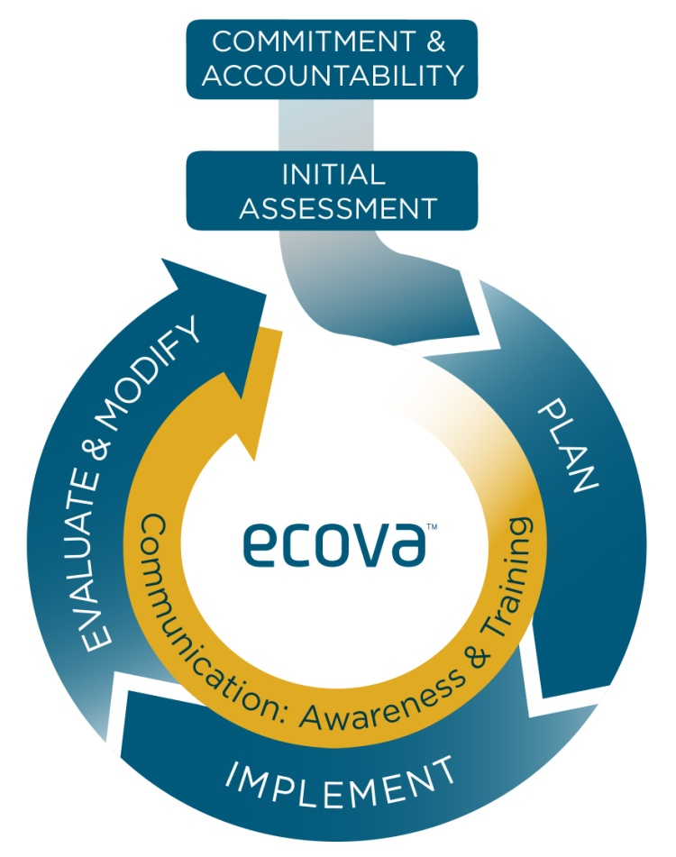
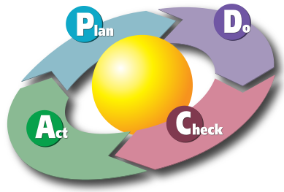
Defining SEM
Continuous Improvement
An ongoing effort to improve the quality of products, services or processes

Slide 9
Defining SEM
Change Management
A structured approach to transitioning individuals, teams, and organizations from a current state to a desired
Project Management
Current
Transition
Future
Change Management

Slide 10
What’s the value of SEM?
Work Force Development
Reduced Operating Costs
Public Relations Opportunities
Long Term Savings Planning
Competitive Advantage
Corporate Stewardship
Environmental Stewardship
Increased Energy Saving Projects
Repeatable Process
Industry Leadership
Employee Engagement
Healthy Return on Investment

Slide 11





Deploy SEM: Implement
Achieving your goal through people
Employees are your eyes and ears
Get them talking
Give them tools
Watch them grow and participate
Enjoy the results

Slide 12
Deploy SEM: Implement
Achieving your goal through people
John Kotter’s 8 Steps
1
Establish a sense of urgency through executive commitment
2
Form a powerful coalition by forming a standing or task based teams
3
Create a vision by establishing an energy reduction goal
4
Communicate the vision by sharing with all employees
5
Empower others to act on the vision through employee engagement
6
Plan for and create short term wins through employee engagement
7
Build on the change through employee engagement
8
Anchor the change in the culture through employee engagement

Slide 13
Deploy SEM: Implement
Achieving your goal through people
Jeff Hiatt’s ADKAR model
Awareness
Ability
Desire
Knowledge
R
E
I
N
F
O
R
C
E
M
E
N
T
What
To do
Not to do
Why
Value
Address fears
How
Training
Sharing
When
Empowerment
Daily
Email
Event
Energy fair
Signage
Exec said
Incentive
Reward
Consequence
Newsletter
Meetings
Email
Training
Suggestion box
Process
Feedback

Slide 14


Fundamentals of Change Management
To Do and Not to Do
Focus on the early adopters, not the resistors
Never believe you’ve communicated enough
Ask why five times to identify root cause
Celebrate in meaningful ways
Think about your audience
Share results early and often
Be kind and understanding
Assume good intention
Recognition
Recognition
Recognition
Recognition

Slide 15
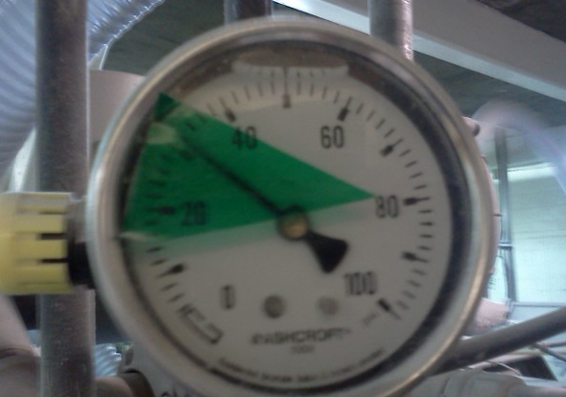
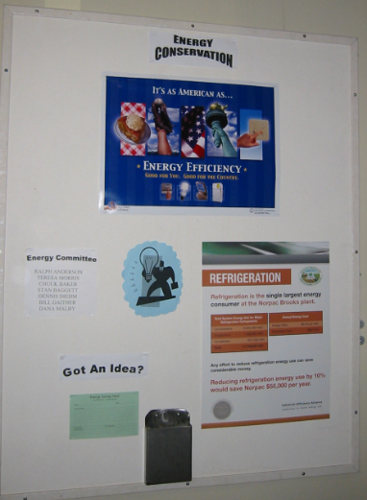
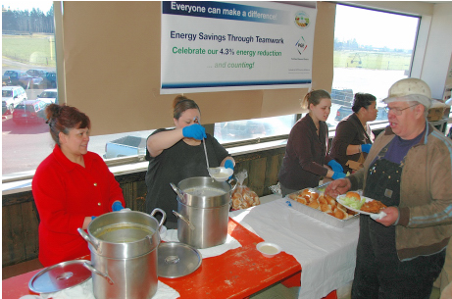
Deploy SEM: Implement
Achieving your goal through people
Remember this is the fun part

Slide 16
Thank You
For further information please contact us at
ecova.com
Virginia Ulrich
vulrich@ecova.com
971 201 4162

